Slide 1
DESIGN
THINKING LAB
COMBINATIONAL CIRCUITS & ITS APPLICATIONS
Nanthan Shetty(RVCE23BCS408)
Manoj Kumar BV(RVCE23BCS409)
Adnan(RVCE23BCS4)
Ujjwal SG(RVCE23BCS421)

Slide 2
INTRODUCTION
Design thinking is a human-centric approach to problem-solving that encourages empathy, creativity, and iterative solutions. In this design thinking project, we focused on combinational circuits AND ITS APPLICATIONS to gain insights into student perspectives, needs, and challenges during the empathy phase.

Slide 3
Objective
EMPATHY PHASE
The primary goal was to understand how students perceive and experience learning about Carry Look-Ahead Adders and to identify areas where they face difficulties.
STAKE HOLDERS
Students : Primary beneficiaries of the project.
Educators/Instructors : Play a key role in the learning process.
Developers : Can provide guidance on integrating new learning materials into educational programs.
Industry Professionals : Have an interest in the practical application of knowledge.

Slide 4
METHODOLOGY
We conducted a survey (Online & Offline) targeting students with varying levels of familiarity with digital logic concepts. The survey included questions about their background, understanding of CLA, learning resources, challenges faced, and preferences for additional support.
Students – 50
Alumni - 5
Students from other colleges - 20

Slide 5

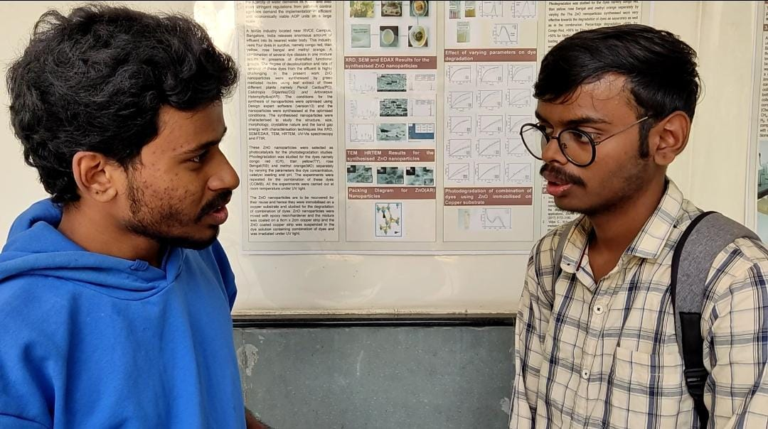
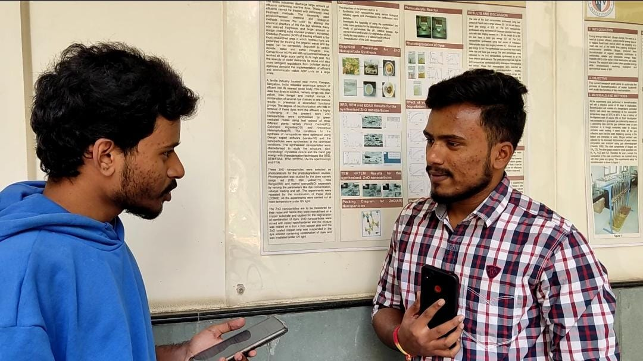


Slide 6



Slide 7
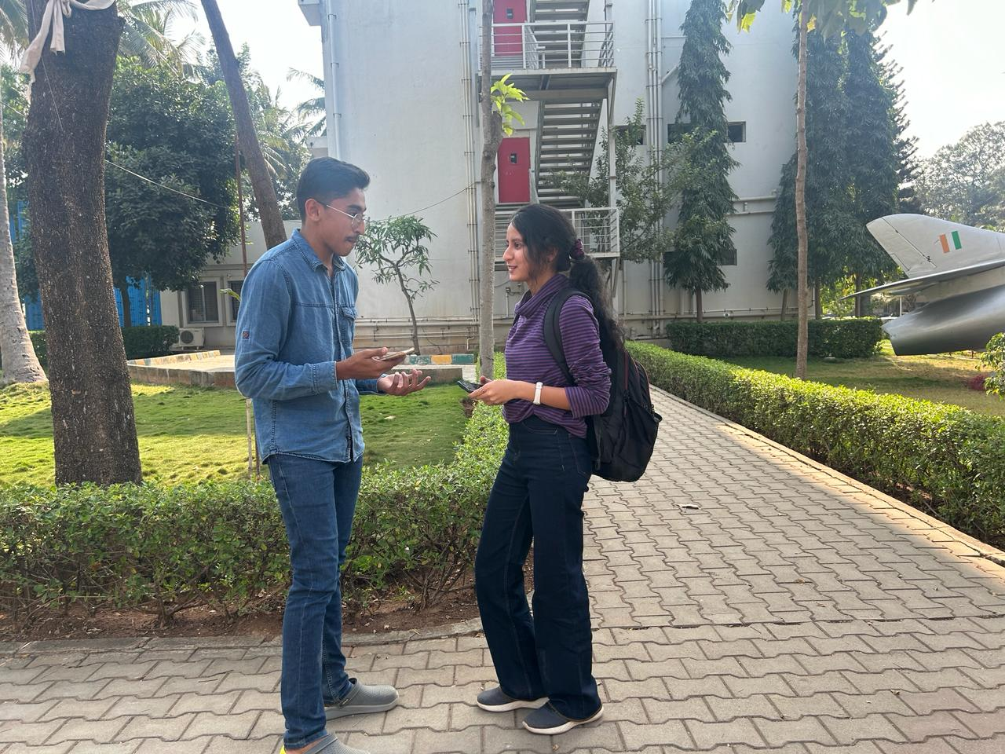
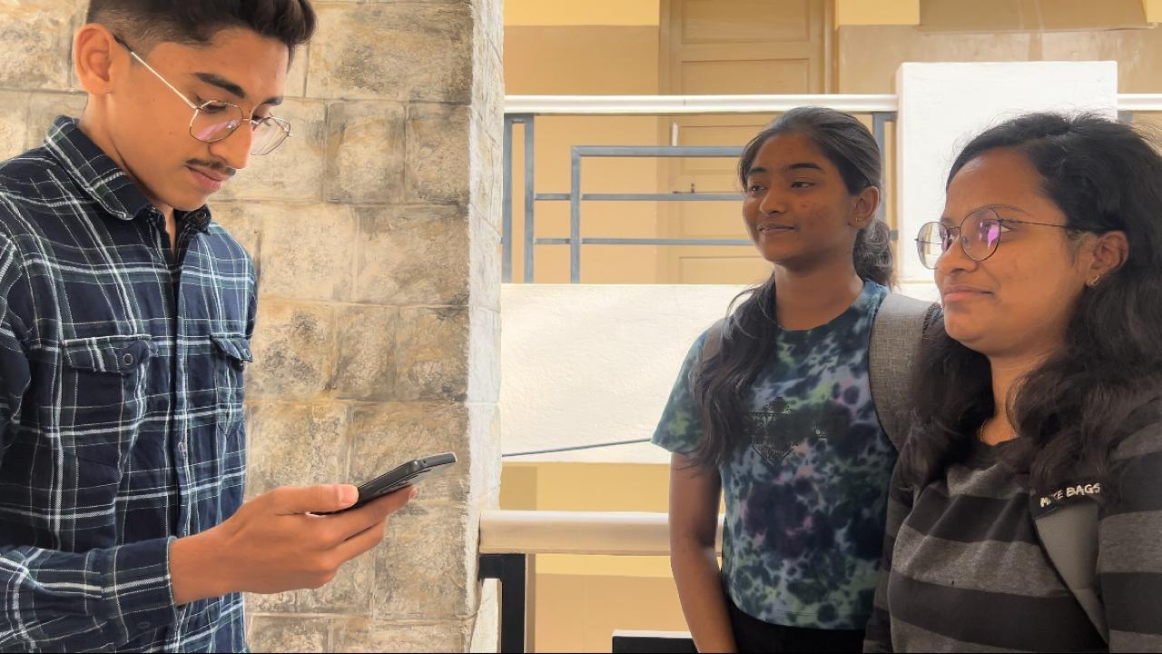
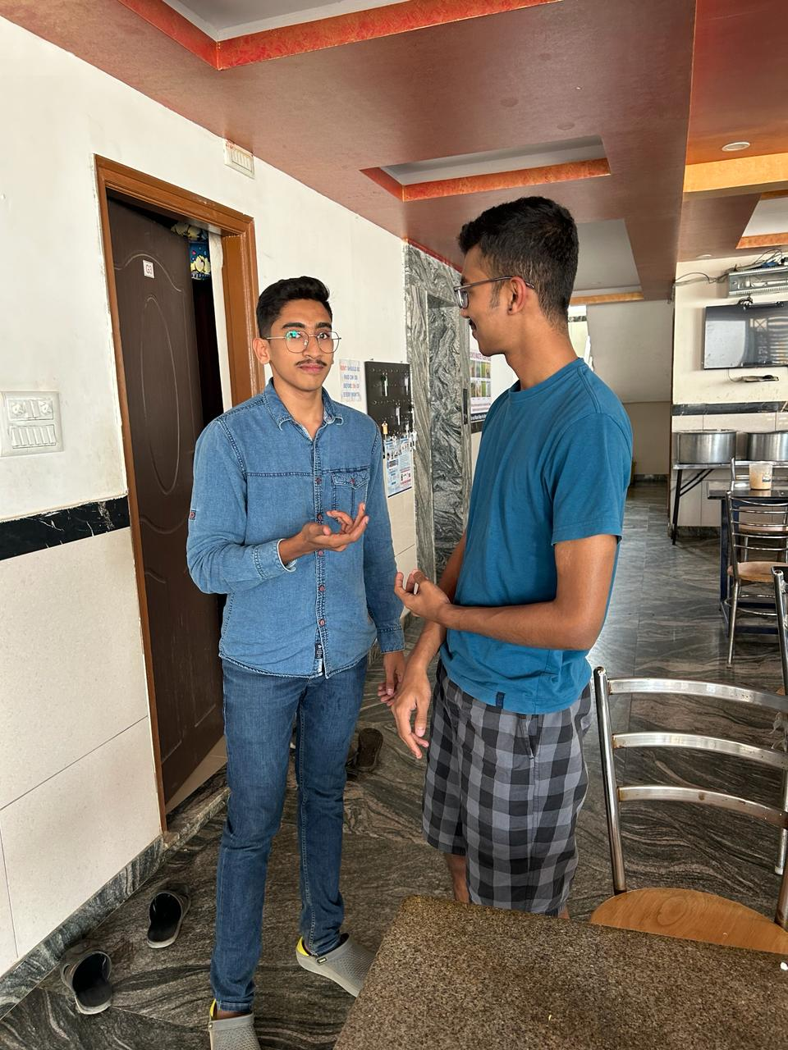
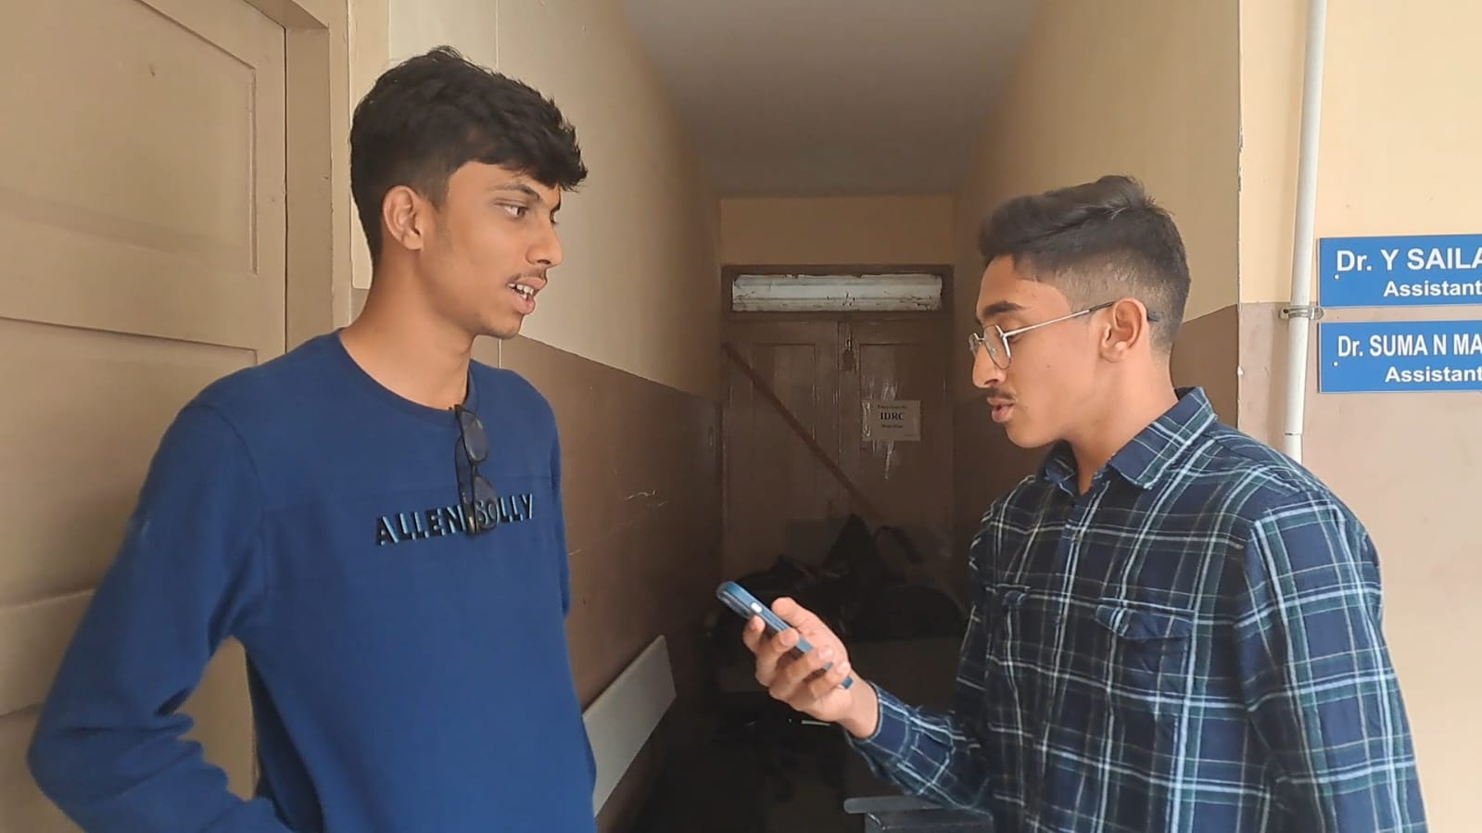

Slide 8
QUESTIONNAIRE FOR STUDENTS
On a scale of 1 to 5, how would you rate your current understanding of combinational circuits?
What specific topics or concepts related to combinational circuits do you find most challenging or interesting?
How do you prefer to learn about combinational circuits?
Are there specific resources or tools you find helpful in understanding combinational circuits? (e.g., textbooks, online platforms, etc.)
On a scale of 1 to 5, how familiar are you with real-world applications of combinational circuits?
What improvements or additions would you like to see in the way combinational circuits are taught or presented?
Do you have any suggestions for incorporating real-world applications of combinational circuits into the curriculum?

Slide 9
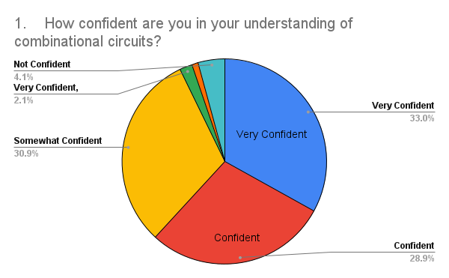
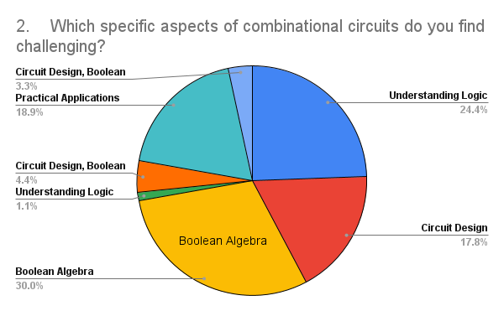
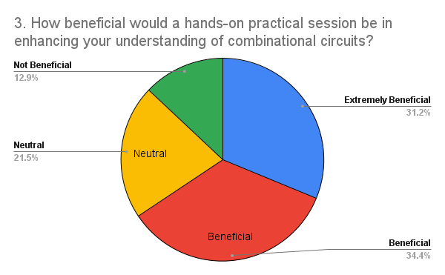
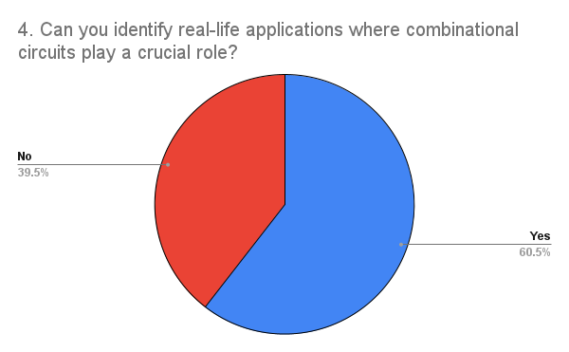

Slide 10
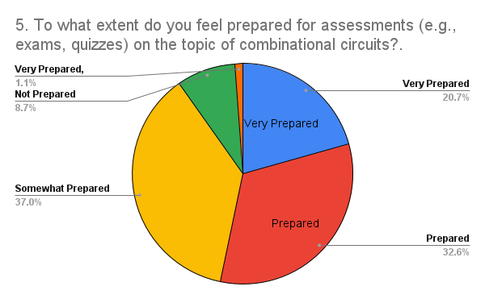
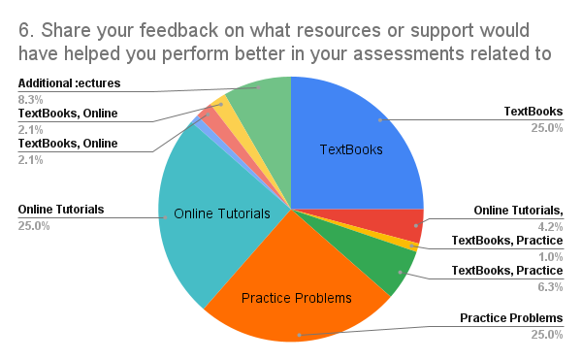
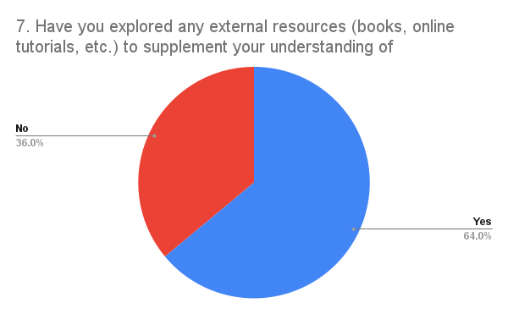
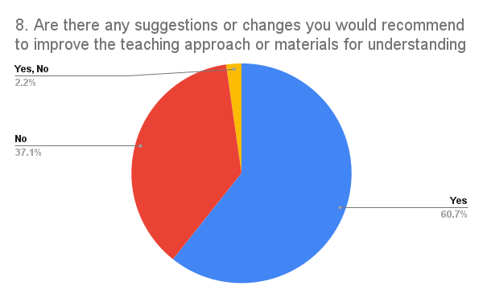

Slide 11
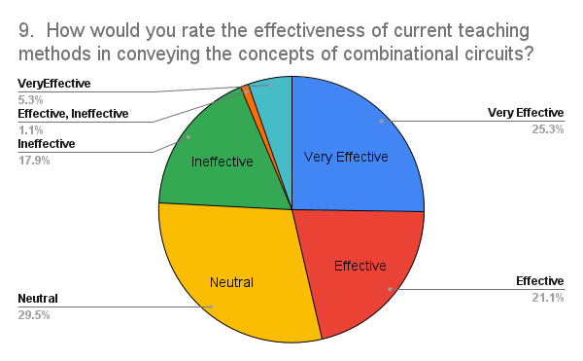
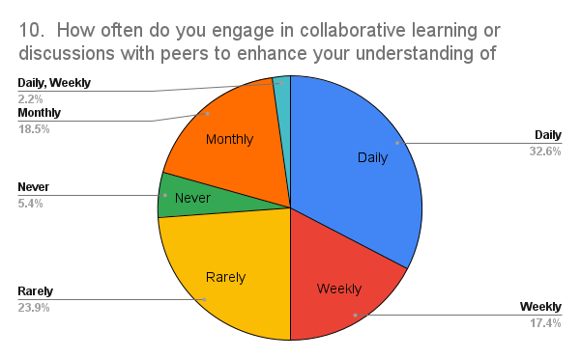

Slide 12
Survey FINDINGS
Majority of participants had a moderate level of familiarity with digital logic concepts.
The explanations of combinational circuits, with some participants showing a solid grasp, while others found certain aspects challenging.
Participants used a mix of textbooks, online resources, and lectures to study .
Participants expressed a preference for interactive learning environments.

Slide 13
EMPATHY MAP FOR STUDENTS

Slide 14
EMPATHY MAP FOR EDUCATORS

Slide 15
EMPATHY MAP FOR INDUSTRY PROFESSIONALS

Slide 16
PROBLEM STATEMENT
Complexity of Logic Design - Carry-lookahead adders involve intricate logic design and can be challenging for students who are still grasping the basics of digital circuit design.
Boolean Algebra and Logic Gates: Students may struggle with Boolean algebra and the implementation of logic gates .
Understanding the Principle and fundamentals: The fundamental principle behind a combinational circuits such as adders and subtractors.
Applications in Arithmetic Operations: Understanding how adders are used in arithmetic operations, such as addition and subtraction

Slide 17
POINT OF VIEW
USER : STUDENTS
Students pursuing studies in electrical engineering, computer science, or related fields.
Need:
Clear understanding of combinational circuits concepts.
Engaging and interactive learning experiences.
Practical applications of theoretical knowledge.
Insights:
Students desire a learning environment that combines theoretical knowledge with hands-on experiences.
Interactive simulations or physical prototyping would enhance comprehension.
Real-world examples and applications can significantly increase motivation and interest.

Slide 18
USER : EDUCATORS/INSTRUCTORS
Educators and instructors responsible for teaching courses in digital electronics or related subjects.
Need:
Effective teaching tools and methods for conveying combinational circuits concepts.
Resources that cater to diverse learning styles.
Assessment tools to measure student comprehension.
Insights:
Educators seek versatile teaching materials that accommodate different learning styles.
Time constraints necessitate efficient tools that balance depth of understanding with practicality.
Assessment tools should gauge both theoretical understanding and practical problem-solving skills..

Slide 19
USER : INDUSTRY PROFESSIONALS
Professionals working in industries related to digital design, hardware development, or electronic systems.
Need:
Graduates with practical knowledge and problem-solving skills in combinational circuits.
Collaboration with educational institutions to bridge the gap between academia and industry.
Continuous learning opportunities for industry professionals.
Insights:
Industry professionals value graduates with hands-on experience in combinational circuits.
Collaboration with educational institutions can enhance the relevance of coursework.
Continuous learning platforms are essential for professionals to stay updated on emerging technologies.

Slide 20
POV TABLE
USER | NEED | PROBLEM | INSIGHTS
Student | Clear understanding of combinational circuits concepts, engaging learning experiences, and practical applications. | Traditional teaching methods may not fully engage students or provide real-world applications. | Students desire a learning environment that combines theoretical knowledge with hands-on experiences.
Educators/Instructors | Effective teaching tools and methods | Balancing theoretical knowledge with practical application in a limited timeframe. | Educators seek versatile teaching materials that accommodate different learning styles.
Industry Professionals | Graduates with practical knowledge and problem-solving skills | Graduates entering the workforce may lack practical skills | Industry professionals value graduates with hands-on experience in combinational circuits.

Slide 21
HOW MIGHT WE QUESTION
STUDENTS
HMW make learning about combinational circuits more engaging and practical for students?
HMW enhance students' understanding of combinational circuits through real-world applications and examples?
HMW facilitate hands-on experiences that allow students to convert abstract circuit concepts into tangible solutions?

Slide 22
HOW MIGHT WE QUESTION
EDUCATORS/INSTRUCTORS
HMW design curriculum and teaching methods that effectively convey the concept of combinational circuits to students of varying backgrounds and learning styles?
HMW integrate real-world case studies and industry applications into combinational circuits courses to make them more relevant and engaging?
HMW develop tools or resources that help instructors visualize and demonstrate complex combinational circuit concepts in an intuitive way?

Slide 23
HOW MIGHT WE QUESTION
INDUSTRY PROFESSIONALS
HMW bridge the gap between theoretical knowledge of combinational circuits and practical applications in the industry?
HMW facilitate a seamless transition for students from academic learning to applying combinational circuit concepts in real-world industry scenarios?
HMW create platforms or initiatives that encourage collaboration between industry professionals and students to solve real-world problems using combinational circuit principles?

Slide 24
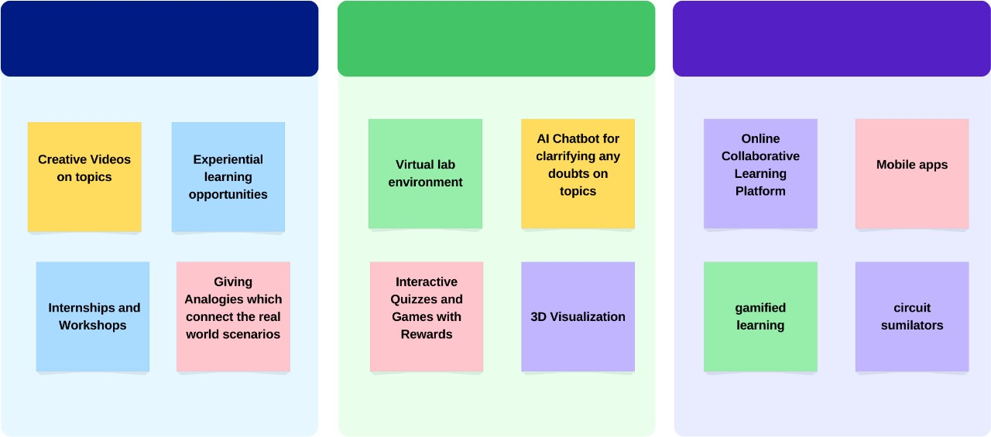
AFFINITY MAP

Slide 25
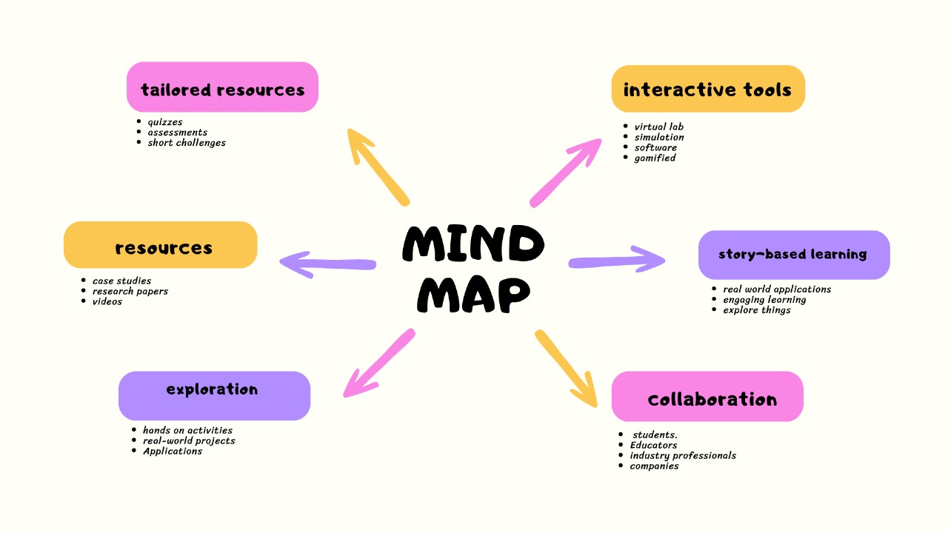
MIND MAP

Slide 26
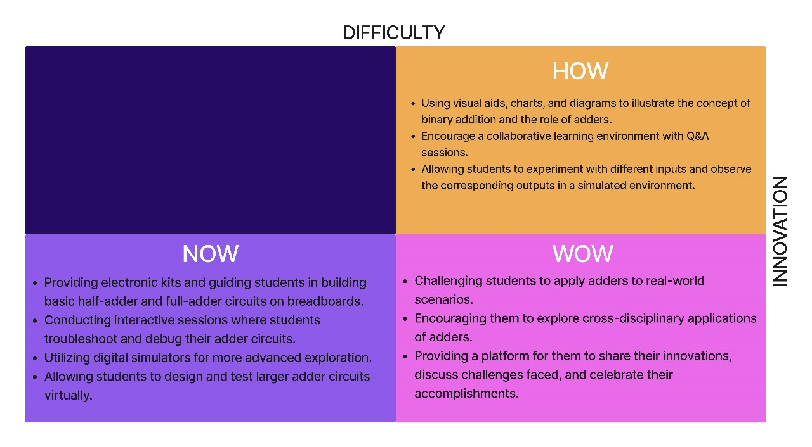
HOW NOW WOW MAP

Slide 27

STORY BOARD

Slide 28
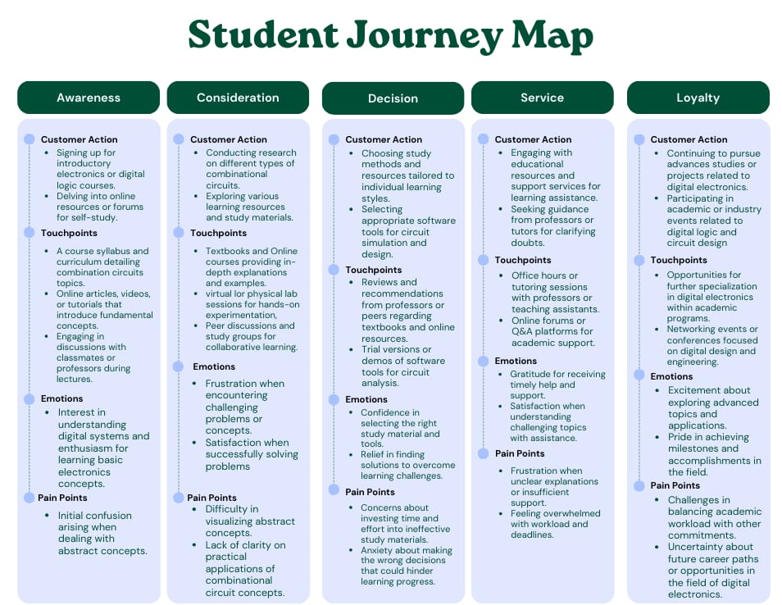

Slide 29
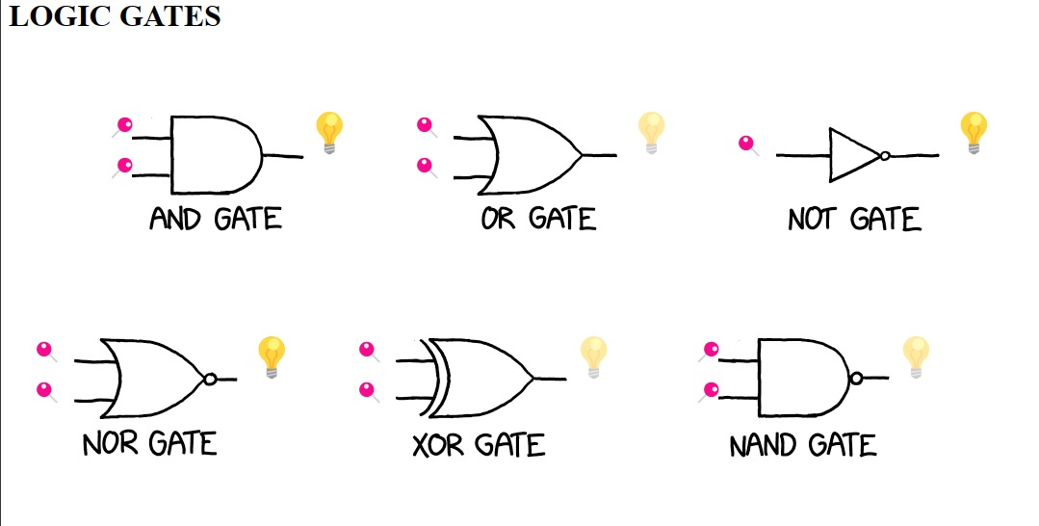
INTARACTIVE WEBSITES

Slide 30
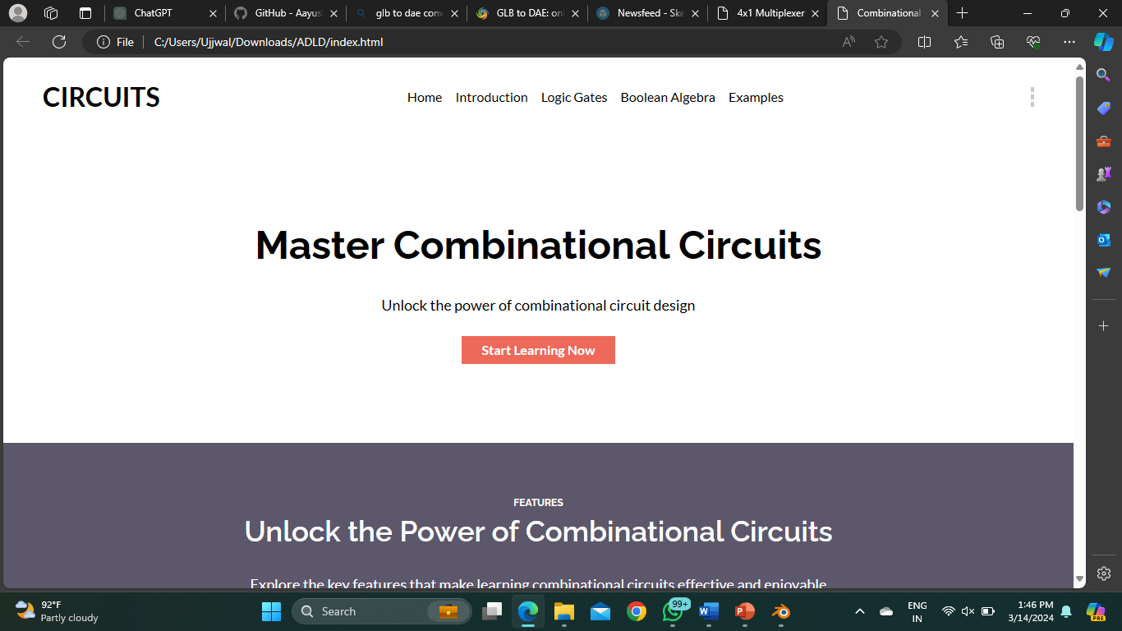
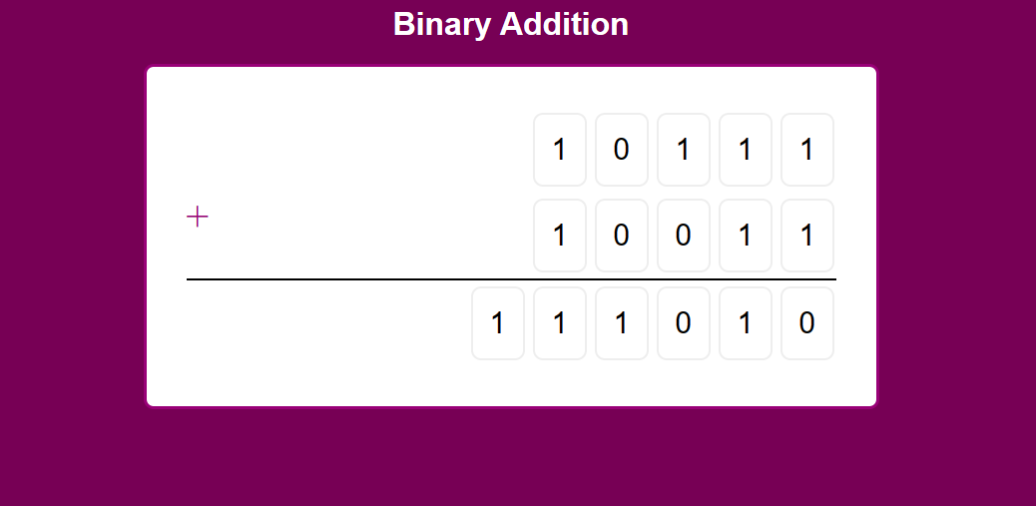
INTARACTIVE WESITES

Slide 31
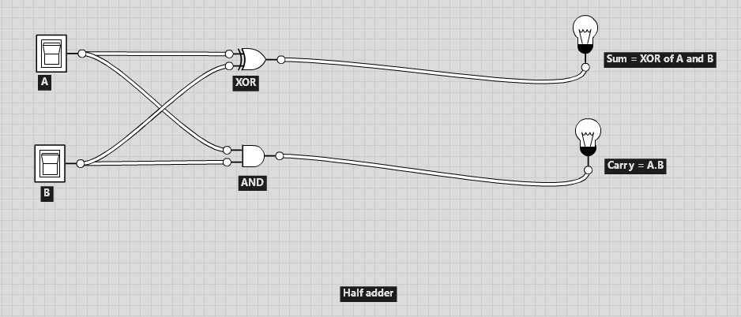
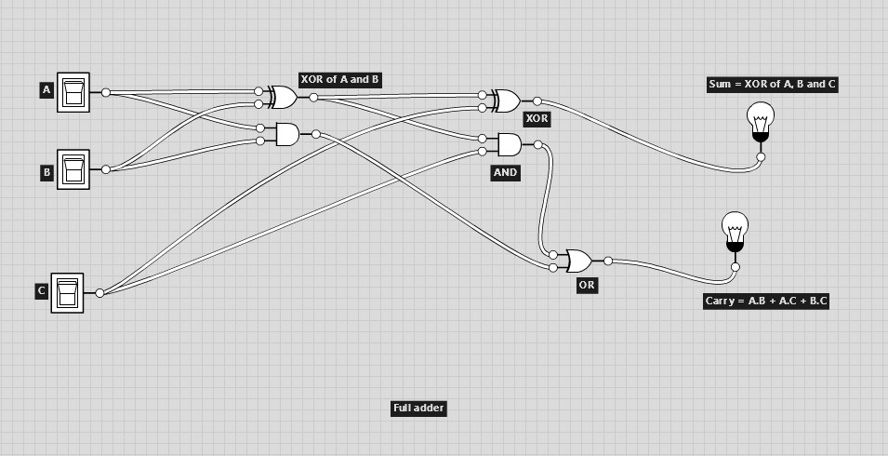
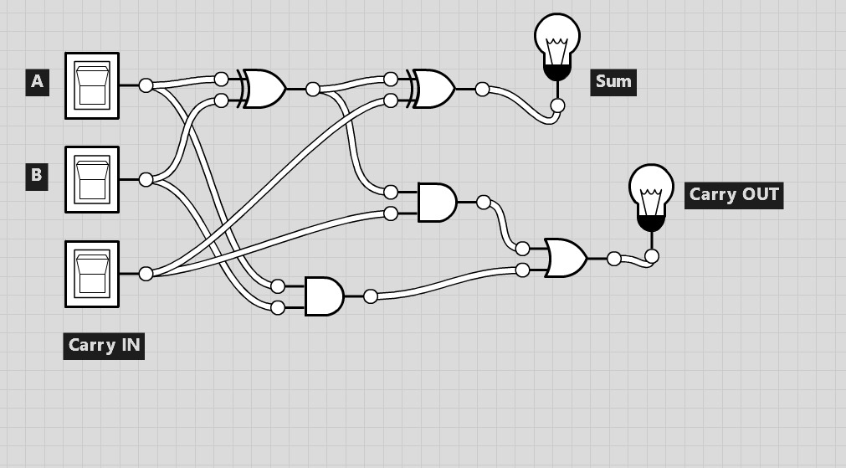
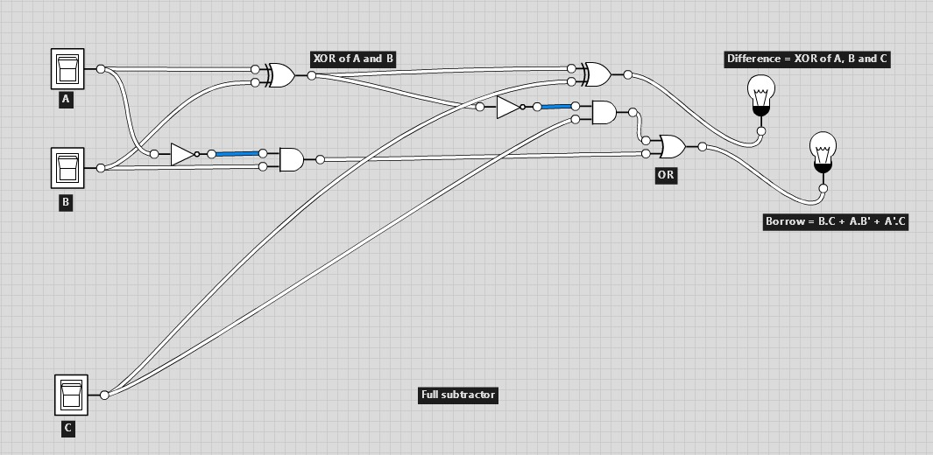
HOW MIGHT WE QUESTION

Slide 32
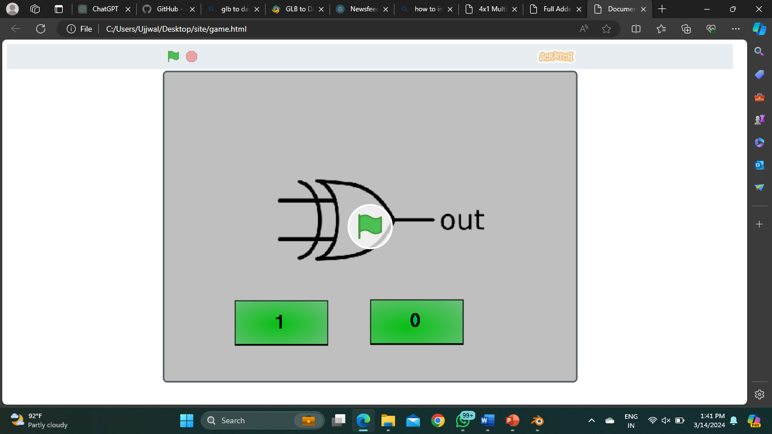
GAMES

Slide 33
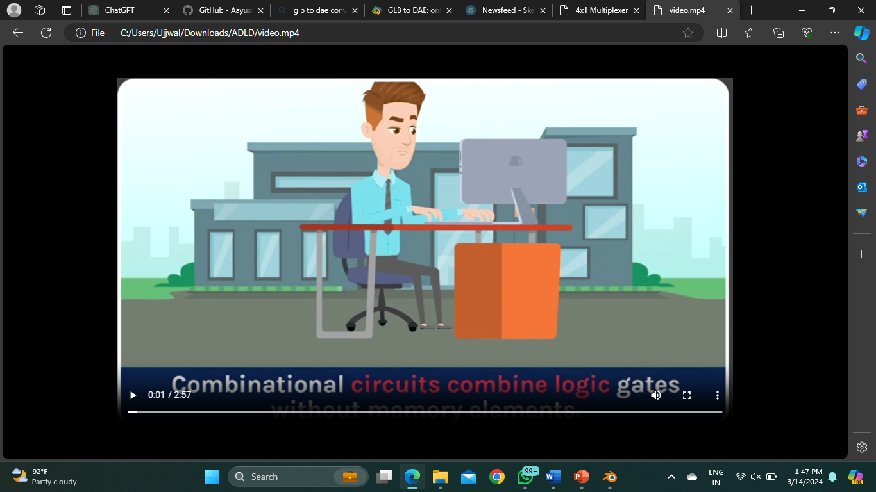
Animated videos

Slide 34
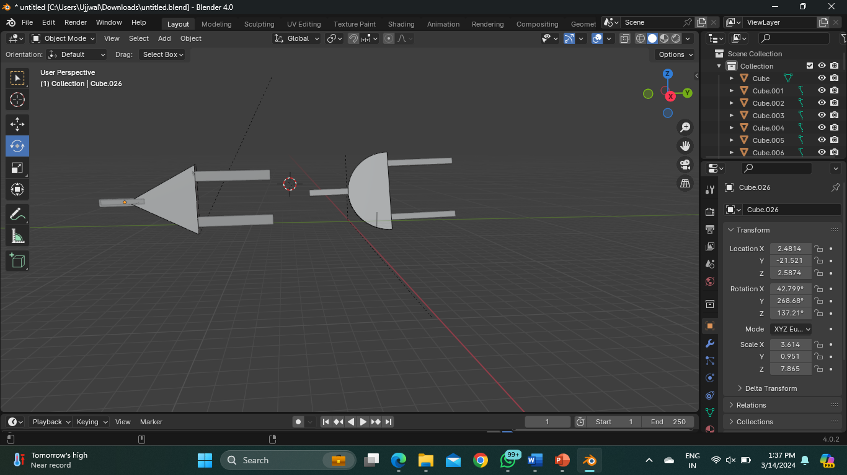
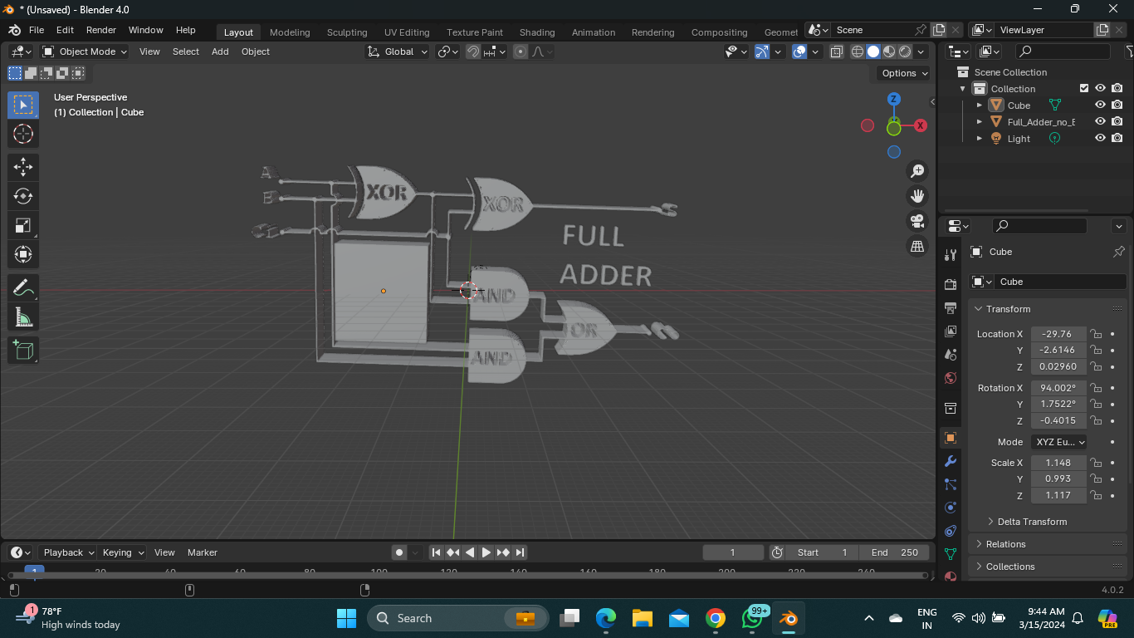
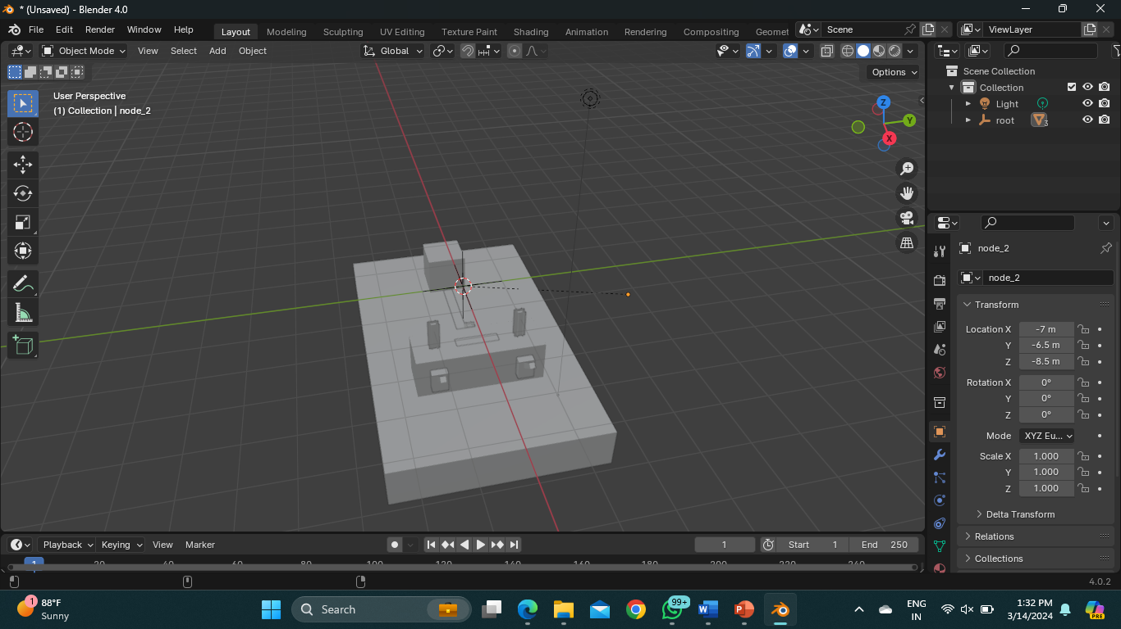
3D Visualization of circuits

Slide 35
THANK YOU

